Slide 1
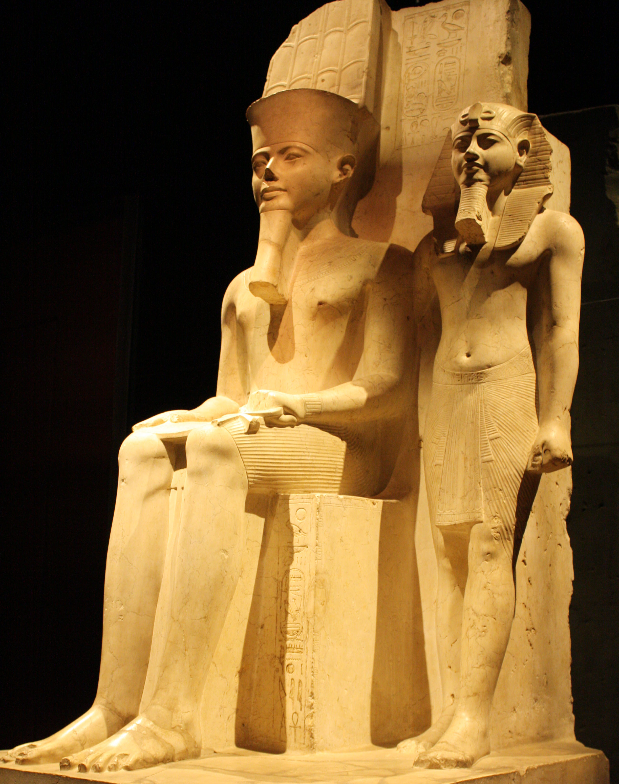
The Cult of Amun
GOAL/S: Describe the significance of the Cult of Amun
Week 8, Lesson 3

Slide 2
The Cult of Amun, centered at Karnak Temple, was more than a religious institution; it was a cornerstone of Egyptian society, exerting influence over politics, economy, and spirituality. Understanding its significance and practices provides a crucial backdrop for comprehending the subsequent upheavals of the Amarna Revolution, wherein the religious landscape of Egypt underwent radical transformation under the reign of Akhenaten.

Slide 3
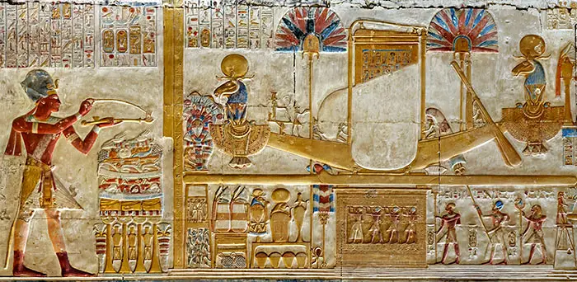
Amun – King of the Egyptian Gods
The Cult of Amun emerged during the Middle Kingdom period (c. 2055–1650 BCE) but reached its height during the New Kingdom (c. 1550–1070 BCE).
Amun, initially a local deity of Thebes, gradually rose to prominence, becoming one of the most powerful gods in the Egyptian pantheon.
Notes:
Among all the multitude of Egyptian deities, the god Amun was considered to be the king of the gods, a supreme creator-god. He was the ancient Egyptian god of fertility and life. While most Egyptian gods were 'born' at various points in the history of the Egyptian nation and many floated in and out of popularity, Amun appears to have been present in the mythology and culture of the Egyptian people almost from the very inception of this complex and mysterious nation.

Slide 4
Amun-Ra
Amun was often depicted as a bearded man wearing a double-plumed crown, symbolizing his fusion with the sun god Ra.
He was associated with creation, fertility, kingship, and the afterlife, embodying the divine attributes revered by the ancient Egyptians.
Priests conducted daily rituals, including offerings, libations, and hymns, to honour and appease Amun.
Special festivals, such as the Opet Festival, celebrated Amun's union with his consort, Mut, and their son, Khonsu, reinforcing the cult's theological significance.
The cult of Amun boasted an oracle, a sacred conduit through which the god communicated with mortals.
Seekers of divine guidance would consult the oracle, housed within Karnak Temple, on matters of state, war, and personal affairs.

Slide 5
Karnak Temple
located in the ancient city of Thebes (modern-day Luxor)
served as the epicenter of the Cult of Amun
not merely a temple but a vast complex of temples, chapels, and obelisks dedicated to various deities, with Amun-Ra being the principal focus
temple complex underwent continuous expansion and renovation over several centuries
reflecting the cult's enduring significance and the pharaohs' devotion to Amun

Slide 6
Just how important was AMUN?

Slide 7
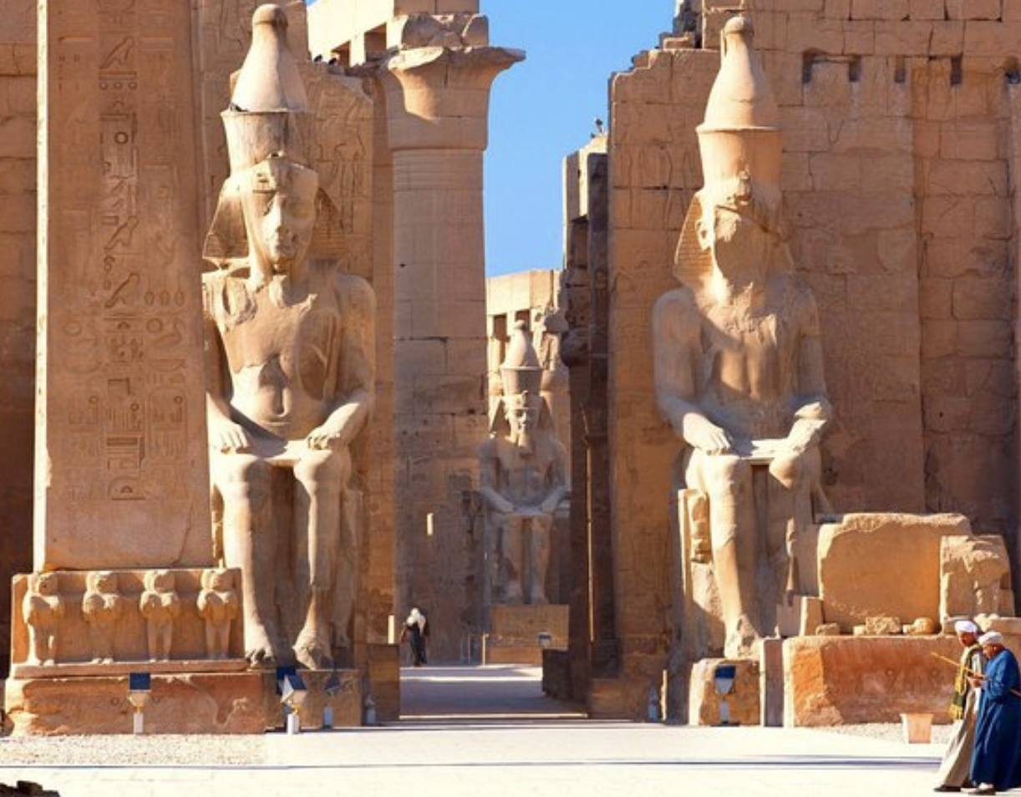
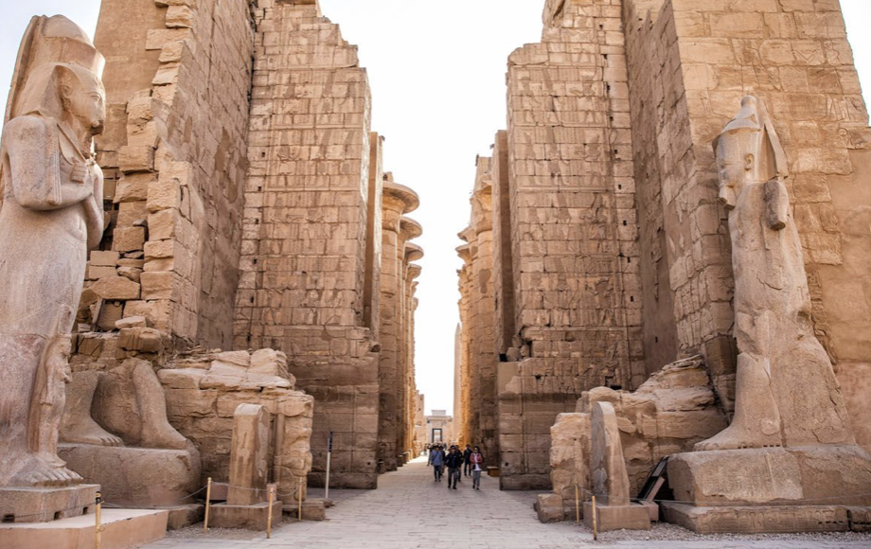
Karnak and Luxor today. L - R Pylons at Karnak and statues of Amun at Luxor
The term "pylon" is used to describe the front wall of an Egyptian temple.

Slide 8
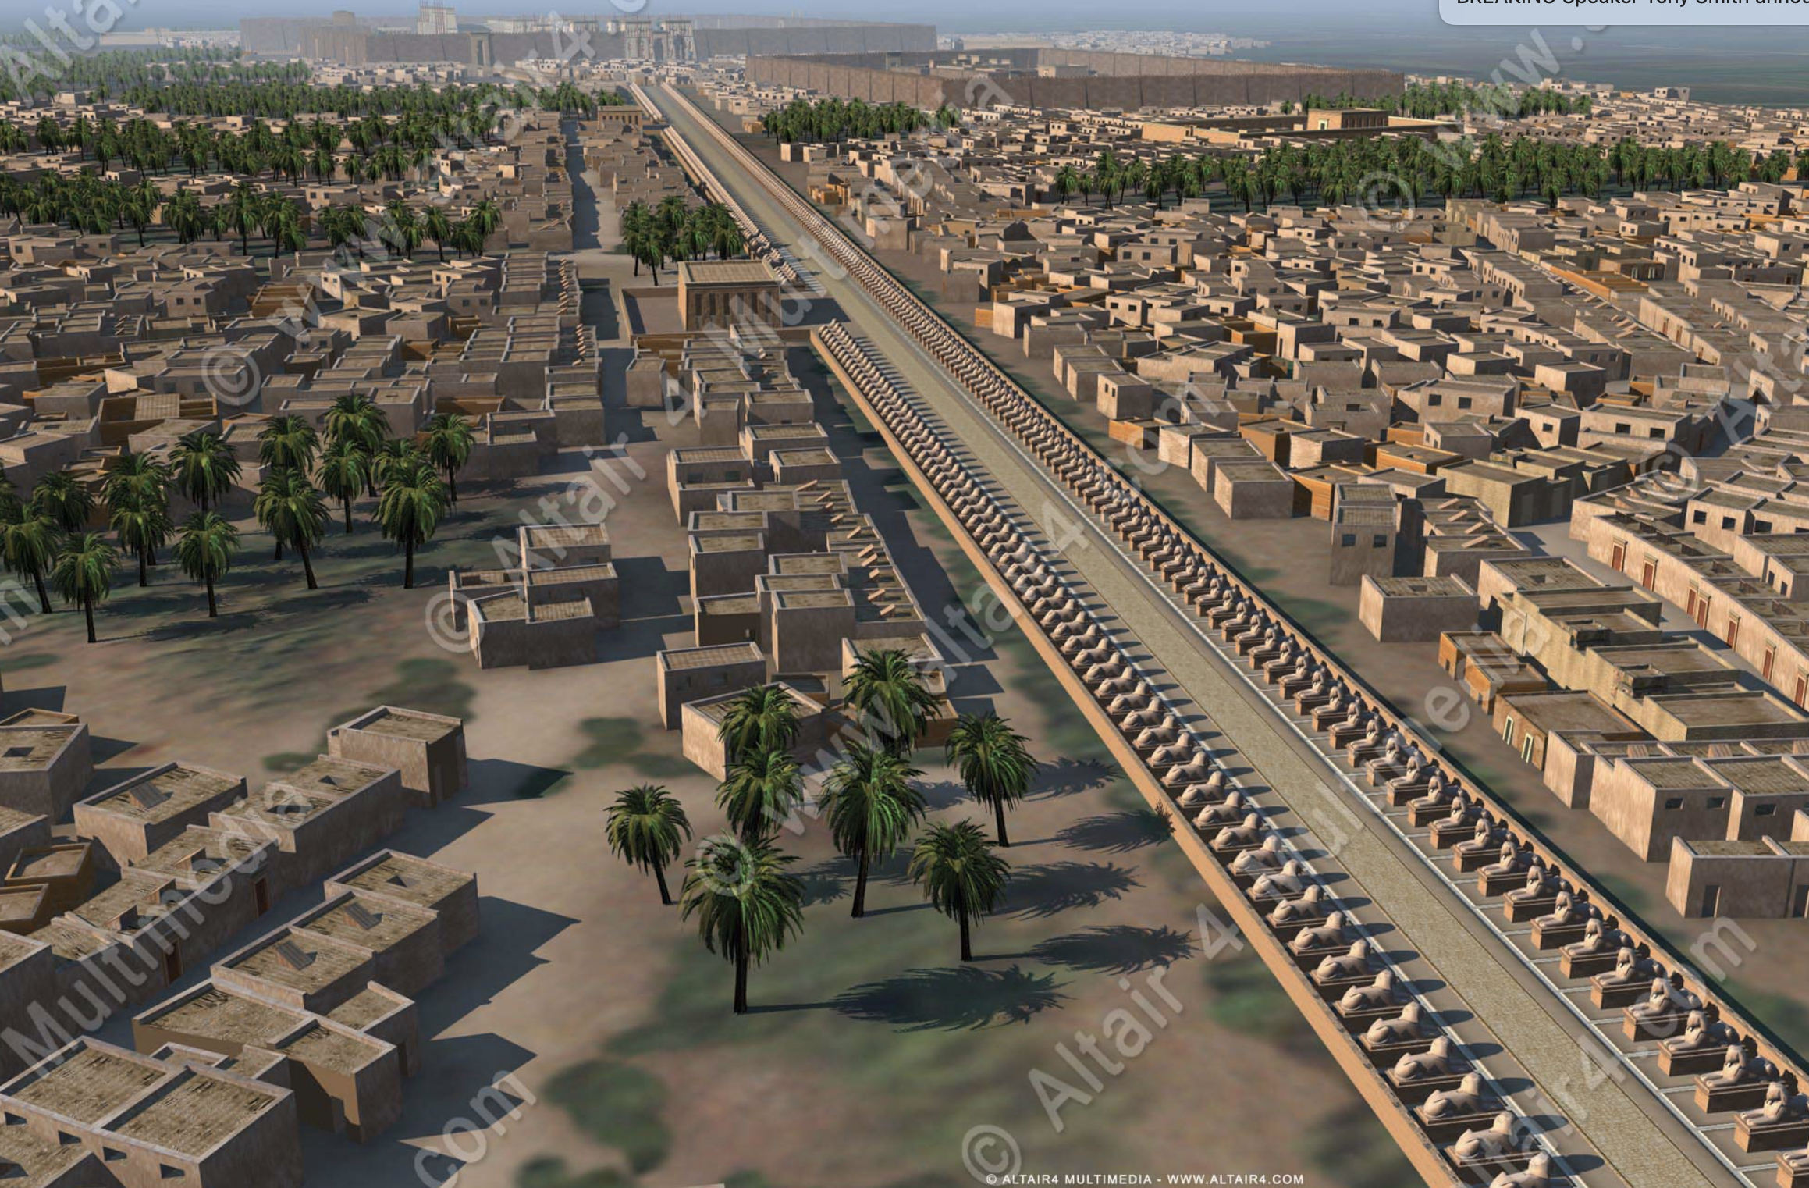
row of Sphinxes connecting Karnak (in background) and Luxor (imagine you are standing on the walls of the Luxor Temple)
KARNAK THEN…

Slide 9
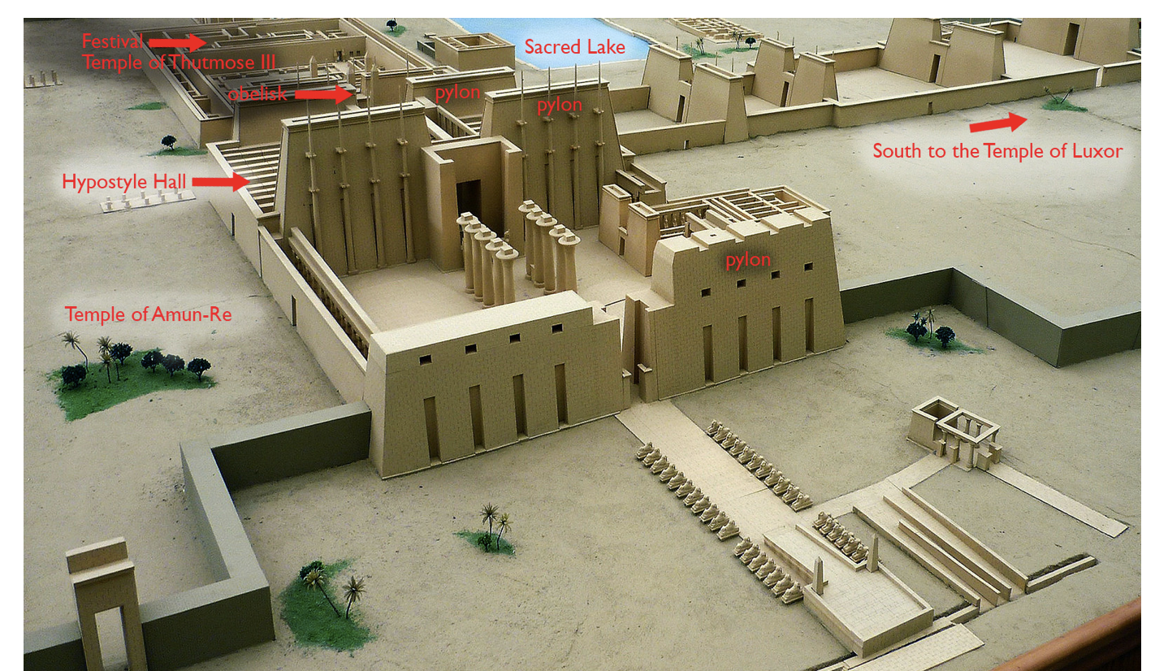
Model of the Precinct of Amun-Ra, Karnak

Slide 10
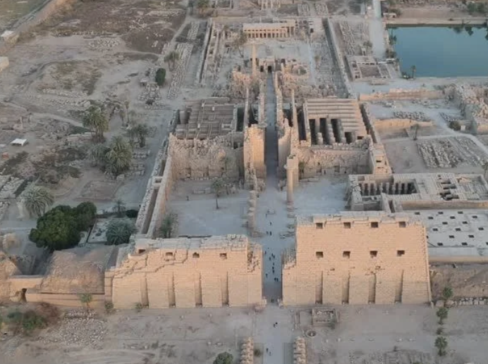
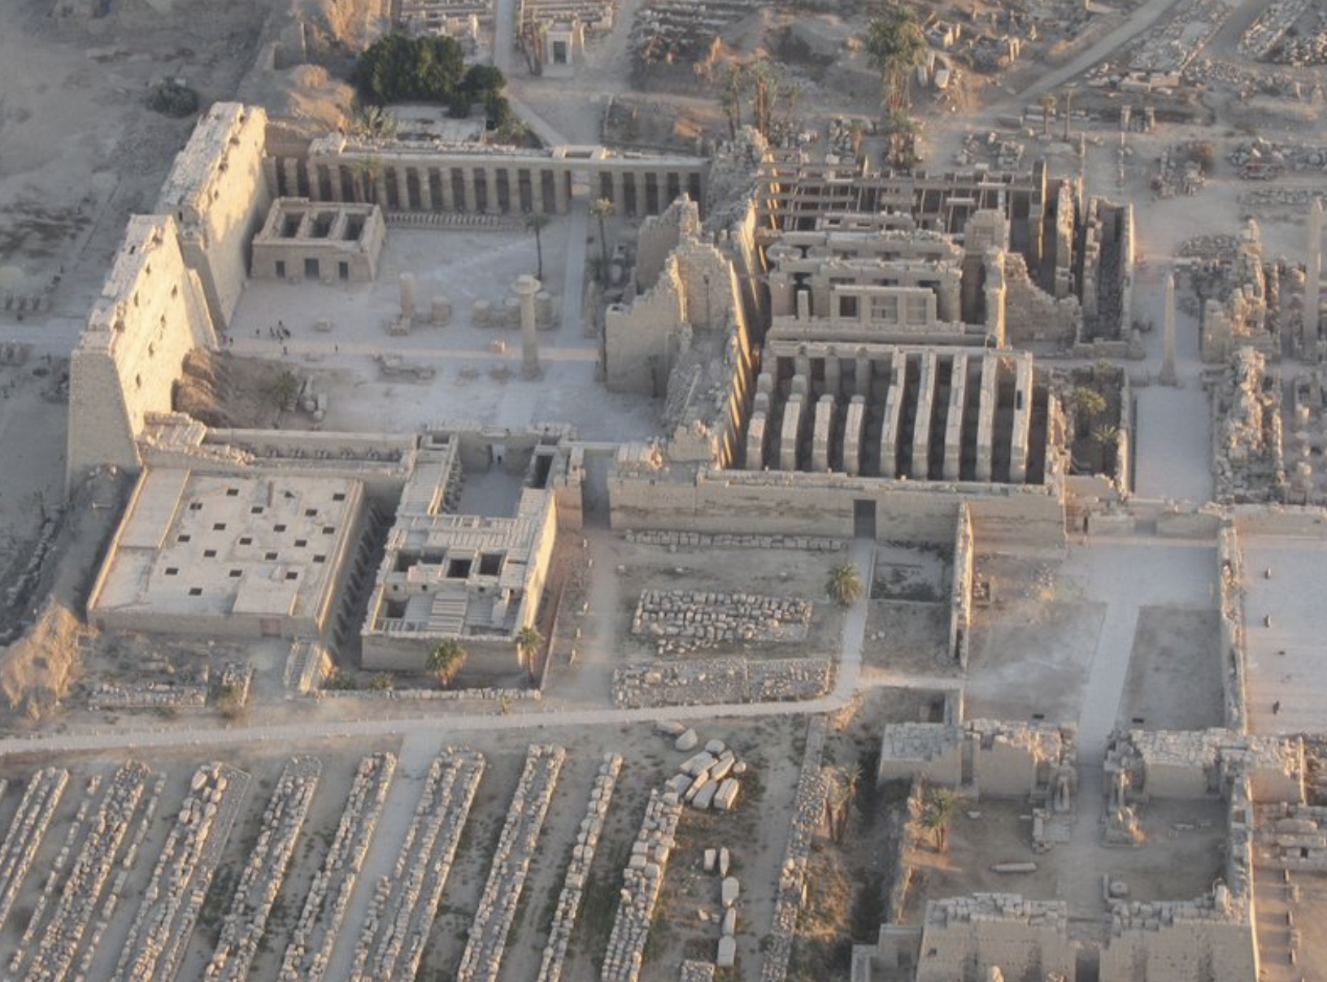
AND NOW…
KARNAK TODAY

Slide 11
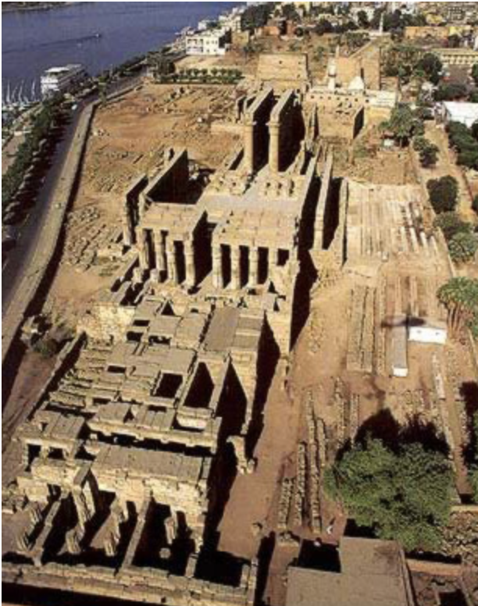
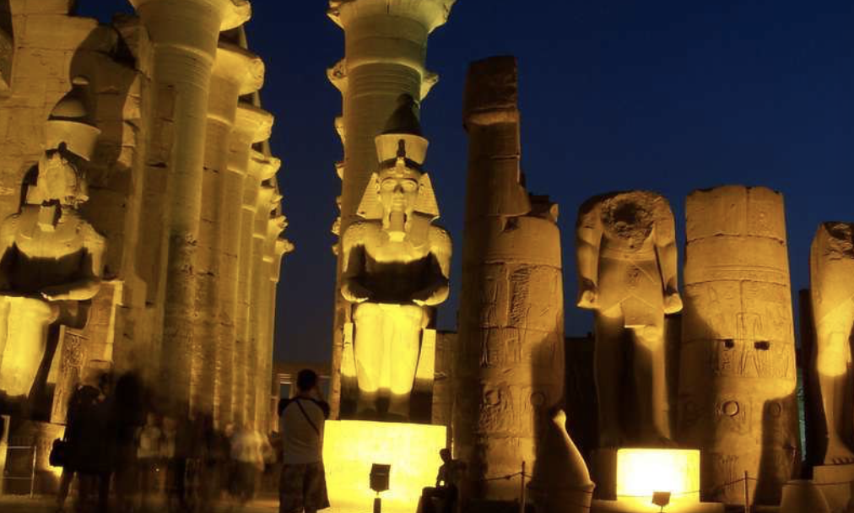
Luxor Temple

Slide 12
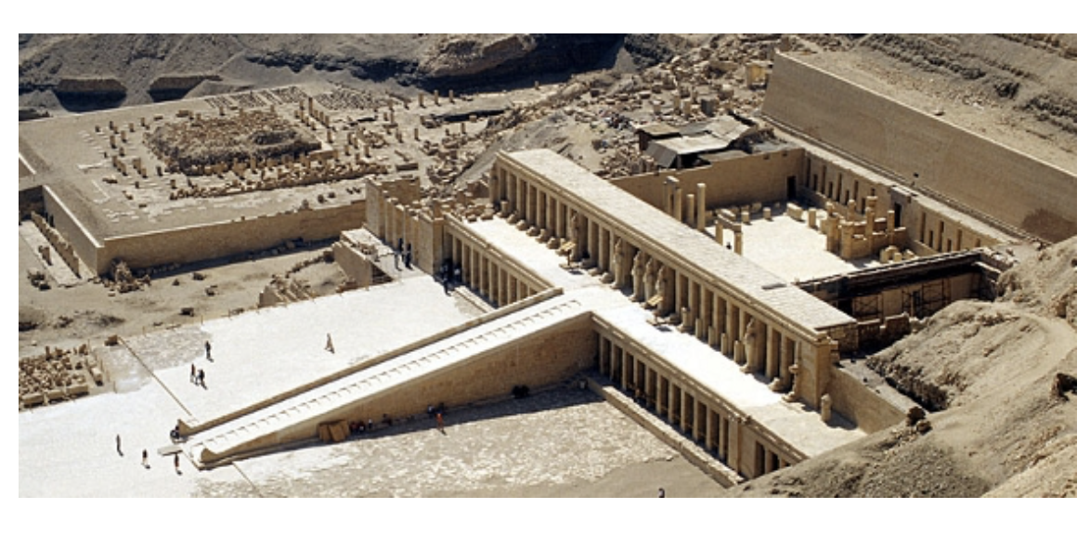
Deir el Bahari – the temple of Hatshepsut

Slide 13
Karnak and Luxor today. L - R Pylons at Karnak and statues of Amun at Luxor
The term "pylon" is used to describe the front wall of an Egyptian temple.

Slide 14
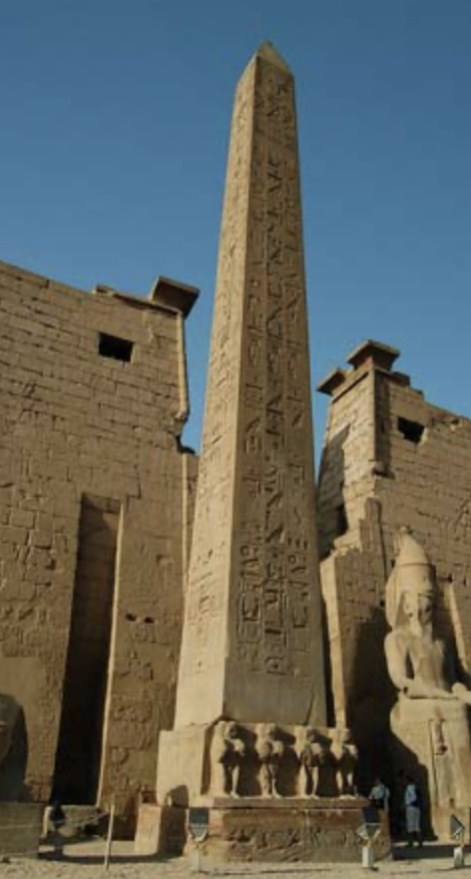
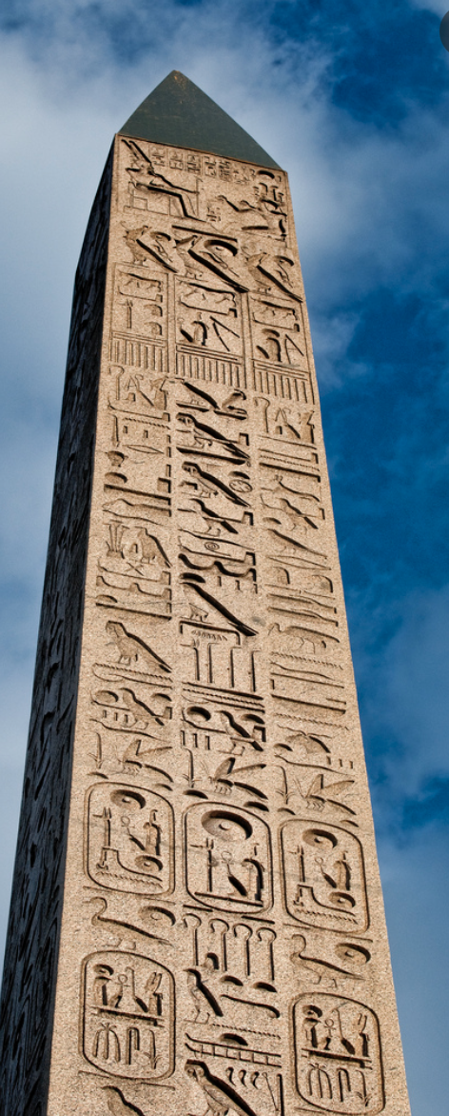
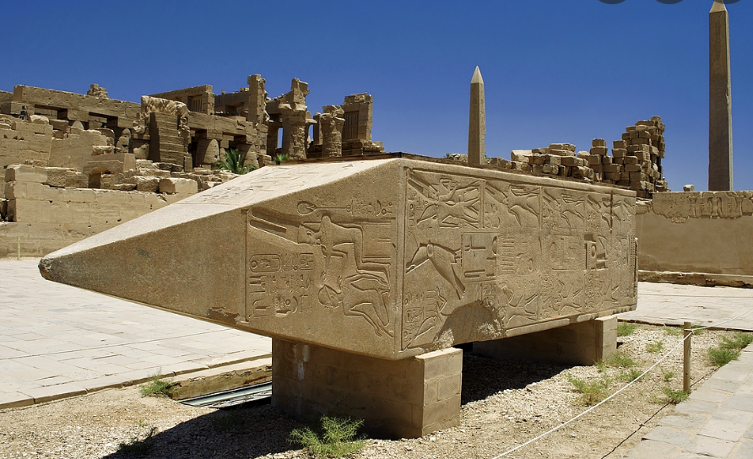
OBELISKS
Hatshepsut’s (bottom left)
Ramses II placed both of the other 2 pink granite Obelisks at the Temple of Luxor, one is still there (left) the other is in Rome (right).
The term ”obelisk” means a tall stone column with four sloping sides and a pointed top, made in honour of an important person or event
Notes:
Hatshepsut’s (middle), Ramses II placed both of the other 2 pink granite Obelisks at the Temple of Luxor, one is still there (left) the other is in Rome.

Slide 15
ACTIVITY - Significance
Create a mindmap of the ‘Significance of the Cult of Amun’

Slide 16
Cult of Amun
SIGNIFICANCE

Slide 17
TEACHER ONLY
A. Political Influence:
1. The priests of Amun wielded considerable political power, often aligning themselves with reigning pharaohs to advance their agenda.
2. Pharaohs sought the favor of Amun to legitimize their rule, often attributing military victories and divine blessings to the god's favor.
B. Economic Power:
1. The immense wealth accumulated by the temple through donations, tributes, and landownership further solidified its influence.
2. The cult controlled vast estates, agricultural lands, and resources, ensuring its economic autonomy and prosperity.
C. Religious Authority:
1. Amun's role as a creator deity and the "king of the gods" positioned the cult at the apex of Egyptian religious hierarchy.
2. Rituals, festivals, and offerings conducted at Karnak Temple were believed to ensure cosmic balance and divine favor.

